Slide 1
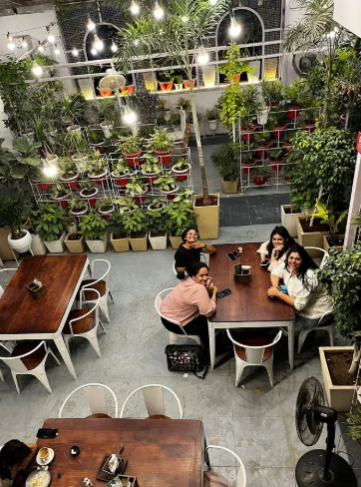
Web development project
Dreamy Café
Online ordering and table booking website
Introduction
Bean & Bloom is a colourful, responsive café website. Guests can browse an illustrated menu, add items to a cart, order from their table and book a seat online. Every form is checked with JavaScript validation, so only correct details are accepted.
HTML5
CSS3
JavaScript
Notes:
Introduce the project: Bean & Bloom Café is a front-end web project built with HTML, CSS and JavaScript. It lets guests view a menu, order from the table and book a seat, with validation on every form.

Slide 2



Problem Statement and Proposed Solution
Problem Statement
Proposed Solution
Long queues. Guests wait in line just to order or to ask what is on the menu.
Missed bookings. Phone reservations are forgotten, double-booked or noted with wrong details.
Paper menus. No pictures, no live prices and no easy way to order from the table.
Visual online menu. Filter by category and add items to the cart in one tap.
Order from the table. Live total, table number and an instant order confirmation.
Validated booking. Name, phone, date, time and guests are checked before anything is sent.
Notes:
Explain the pain points of a typical café: queues, missed phone bookings and paper menus. Then show how the website solves each one.

Slide 3



Technologies Used
HTML5
CSS3
JavaScript
Structure
Style and layout
Behaviour
Semantic header, main and footer
Forms with labels and input types
Dialog element for confirmations
Flexbox and Grid layouts
CSS variables for the colour theme
Animations, focus states, dark mode
Menu filter and shopping cart
Real-time form validation
DOM events and the Date object
Also used
SVG artwork
Google Fonts
Regular expressions
Responsive design
Notes:
HTML gives the page its structure, CSS makes it colourful and responsive, and JavaScript adds the menu filter, cart and the validation on every form.

Slide 4






Main Features
Interactive menu
Smart cart
Validation rules
Eight illustrated dishes with category filters.
Add, remove and see a live total and item count.
Name letters only, 3 to 40 characters
Email must look like name@example.com
Phone 10 to 13 digits, letters blocked
Guests whole number from 1 to 12
Date not in the past, within 60 days
Time 8:00 AM to 9:30 PM
Request max 200 characters, no < or >
Terms checkbox must be ticked
Table booking
Instant validation
Choose date, time and guests in one simple form.
Errors and green ticks appear as you type.
Fully responsive
Order confirmation
Looks great on phone, tablet and desktop.
A pop-up summary with the order number.
Notes:
Highlight the validation rules: each field is checked on blur and on every keystroke, and the form will not submit until every rule passes.

Slide 5
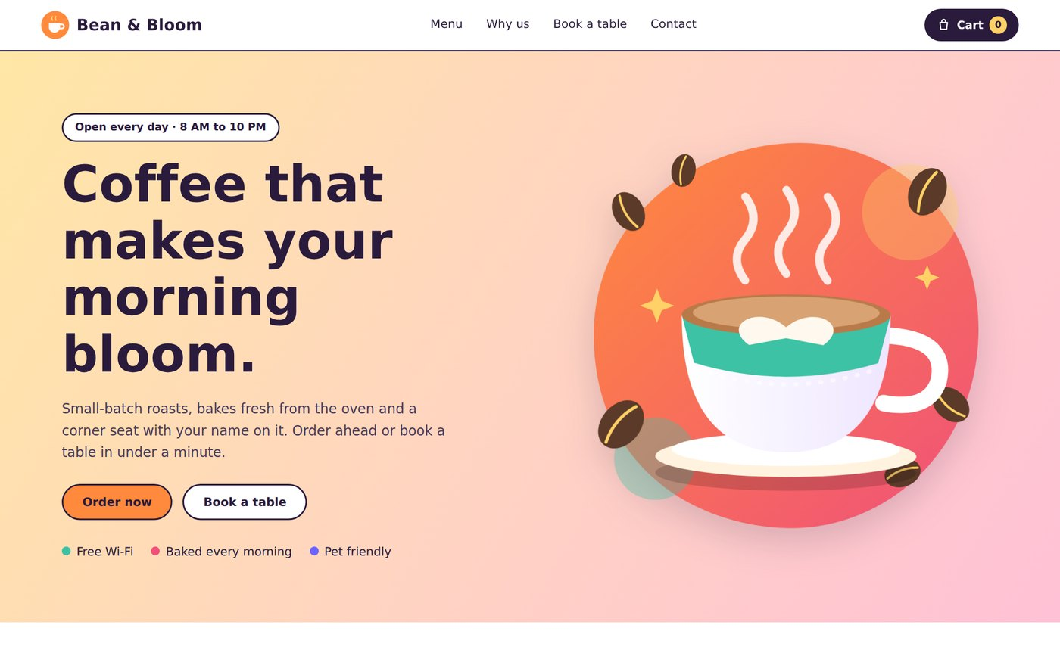
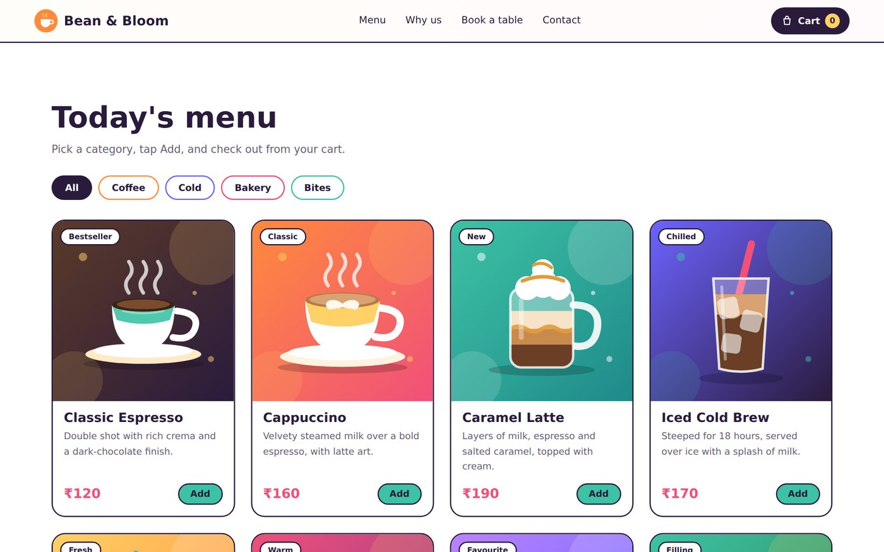
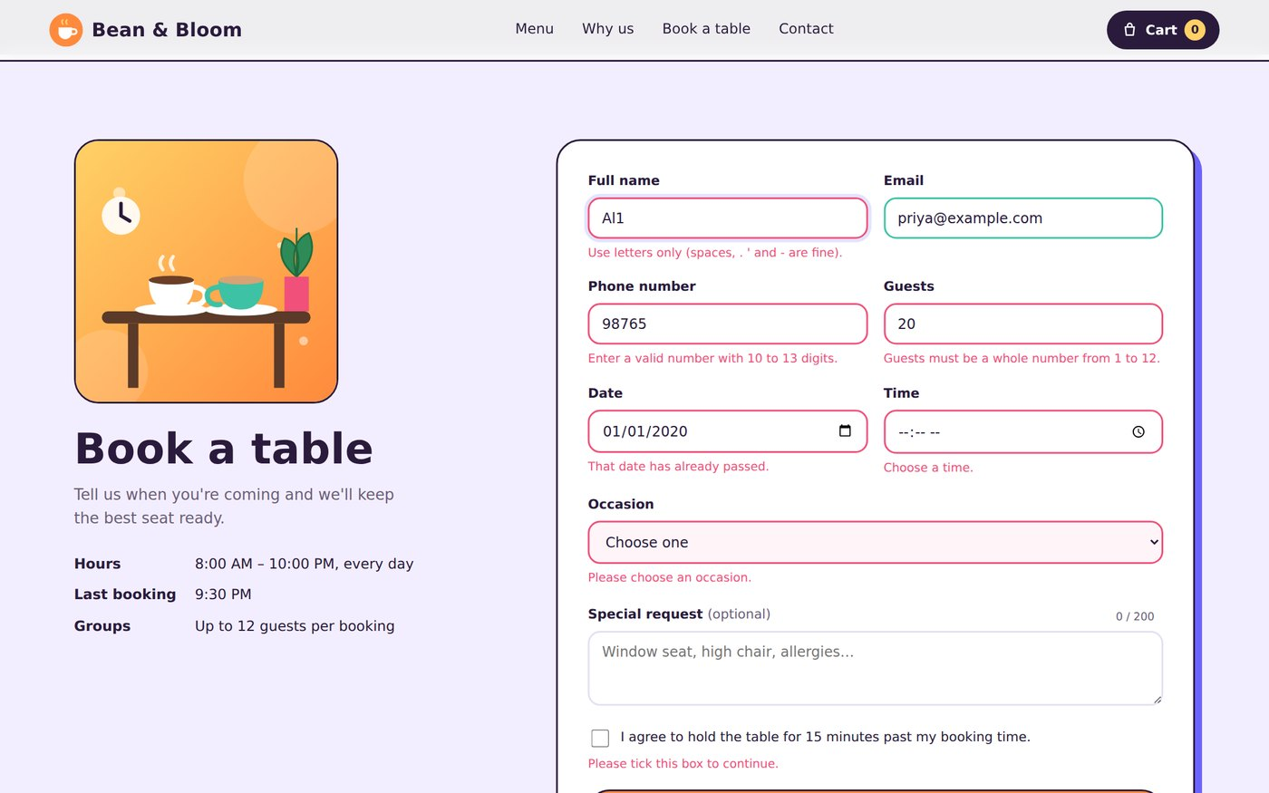
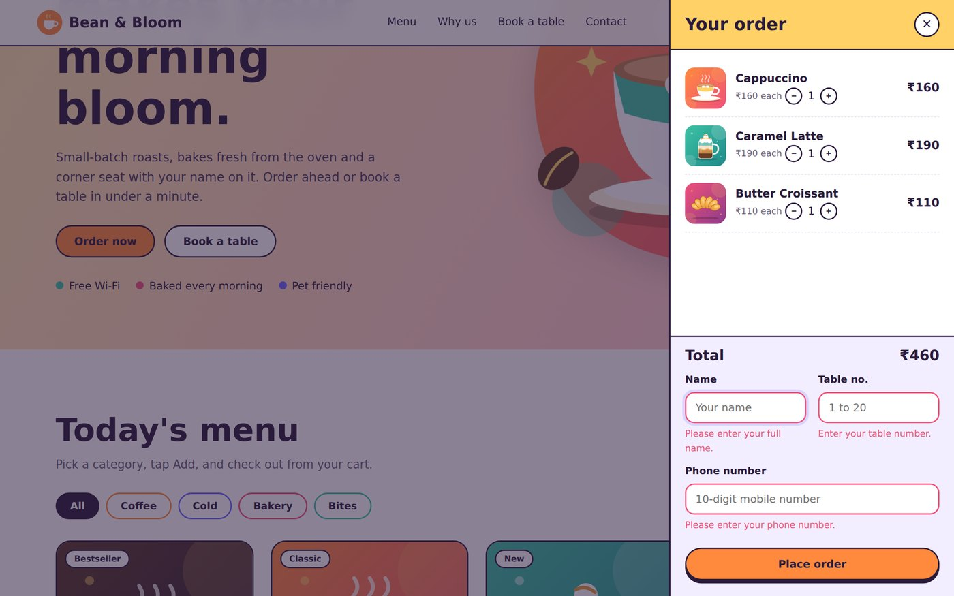
Project Screenshots and Live Demo
Live demo
Try the working website in your browser.
Open live demo
Home page
Menu with filters
claude.ai/artifact/QyCqH66enWY6iMNYMDnC5B
What to try
Add dishes and open the cart
Press Place order with empty fields
Fill in valid details and confirm
Form validation
Cart and checkout
Notes:
Open the live demo link. Add a few dishes, open the cart, submit with empty fields to show the validation errors, then fill correct details to see the confirmation pop-up. Note: the published page is private until you press Share on it.

Slide 6

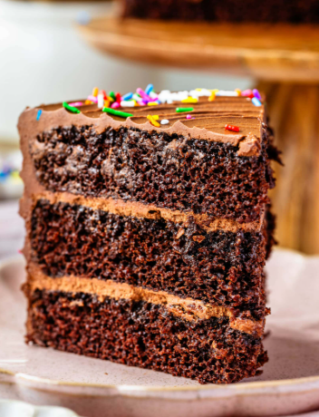
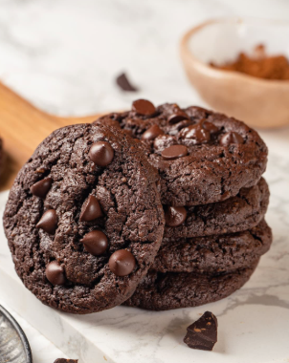
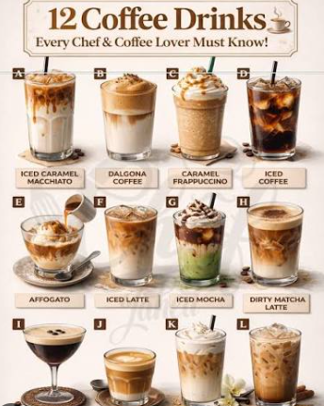
Conclusion
HTML, CSS and JavaScript alone can deliver a complete ordering and booking experience.
Real-time validation keeps data clean and guides guests with clear messages.
The colourful, responsive design works on every screen, from phone to desktop.
Link
Online payments
Login and order history
Backend database
Kitchen dashboard
Thank you!
Notes:
Wrap up: summarise what was built and what could be added next, such as online payments, user accounts and a real database.

